Slide 1

Data Description
Session 2
M. Kachour

Slide 2
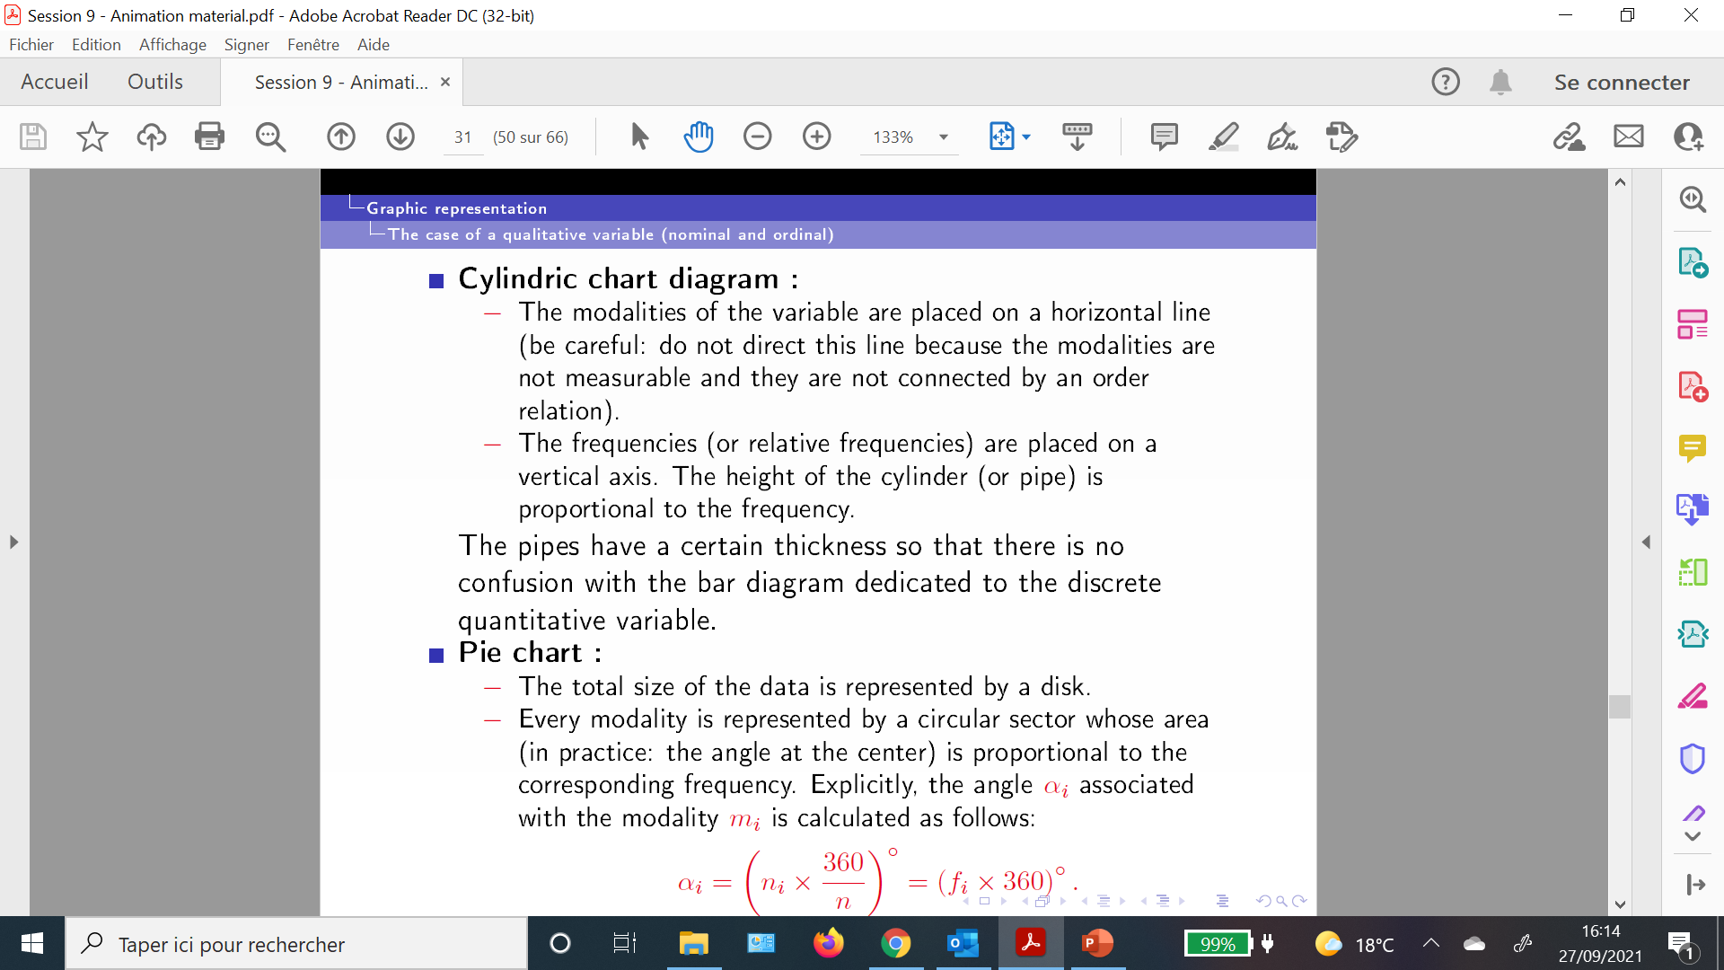

Graphical representation of data
The case of data from a qualitative variable :
The bar chart
The pie chart

Slide 3
Example
The table below shows a country's budget
Source | Amount (billion)
VAT | 348
Income taxes | 163
Corporate taxes | 71
Taxes on petroleum products | 54
Other taxes | 161
Non-tax revenue | 41

Slide 4
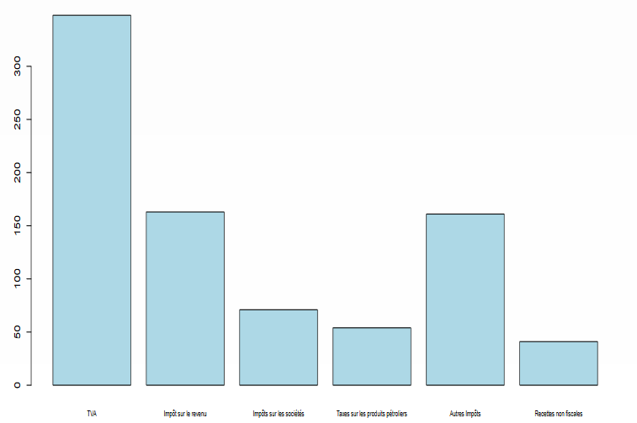
Example

Slide 5
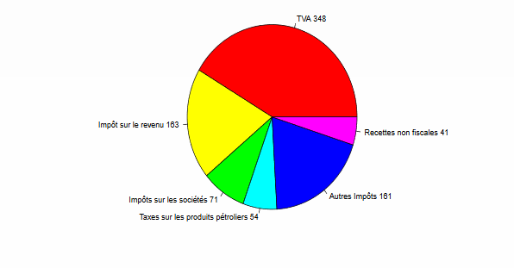
Example

Slide 6
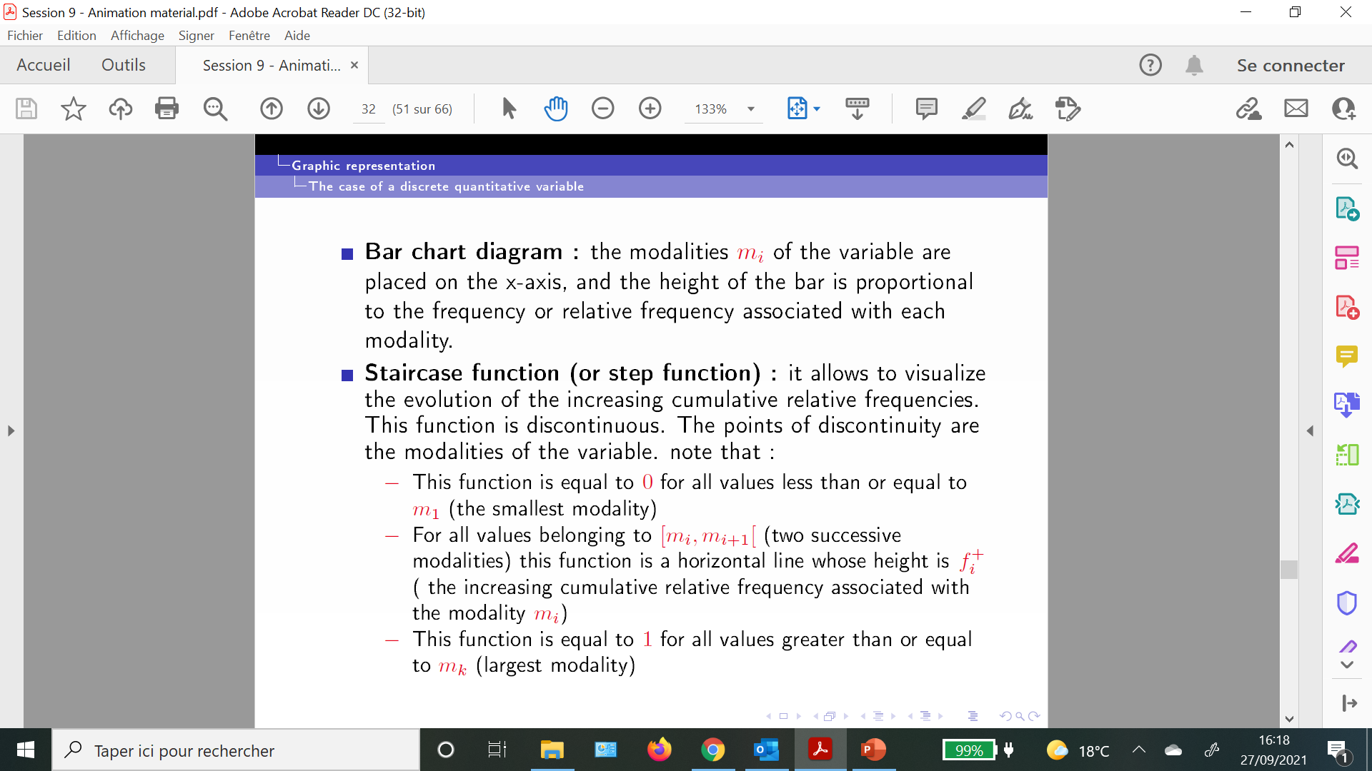
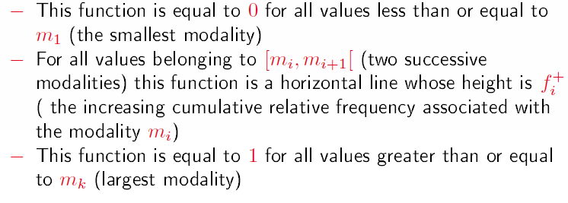
Graphical representation of data
The case of data from a discrete variable

Slide 7
Example
Data in table below represents the number of calls (observed over 396 days) received between 12.00 and 13.00, at the after sales service of a big store:.
Objectives :
- Represent graphically the data
- Plot the curve of increasing cumulative frequencies
Number of calls | Number of days
0 | 101
1 | 140
2 | 92
3 | 42
4 | 18
5 | 3

Slide 8
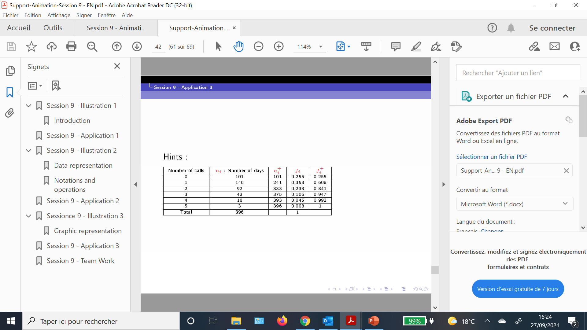
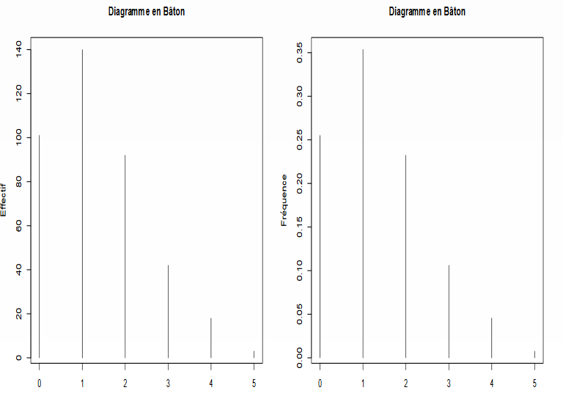
Example

Slide 9
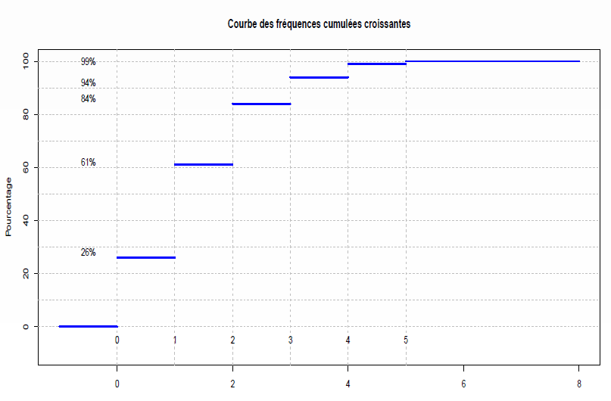

Example – Curve of $f_{i}^{+}$

Slide 10
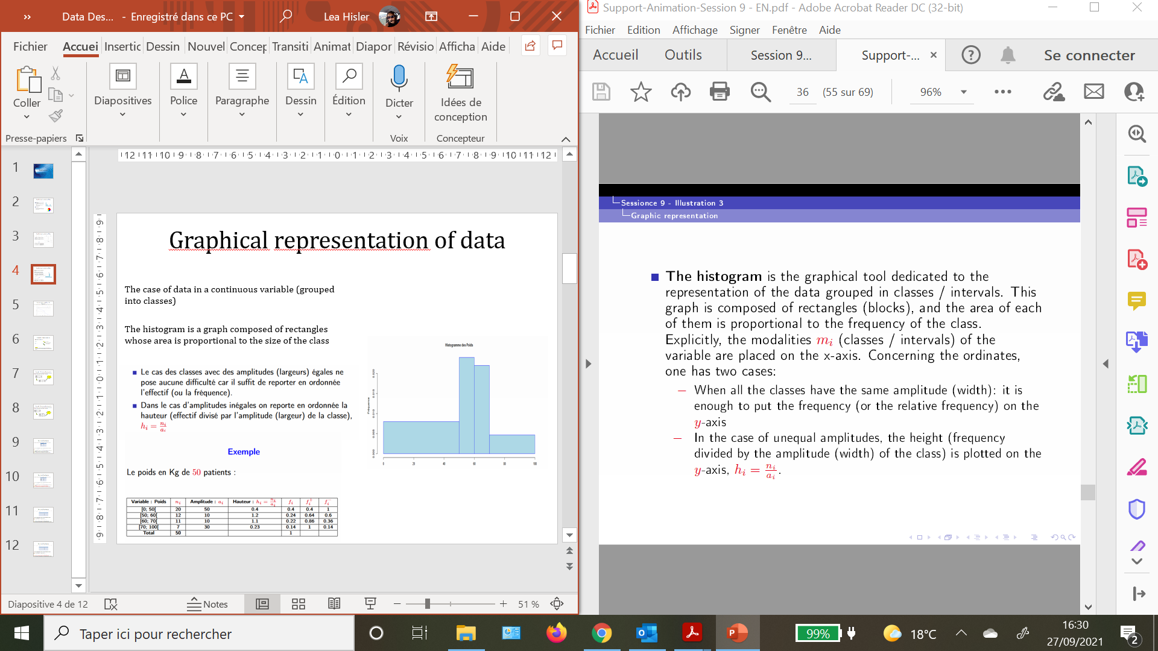
Graphical representation of data
The case of data in a continuous variable (grouped into classes)
The histogram is a graph composed of rectangles whose area is proportional to the size of the class

Slide 11
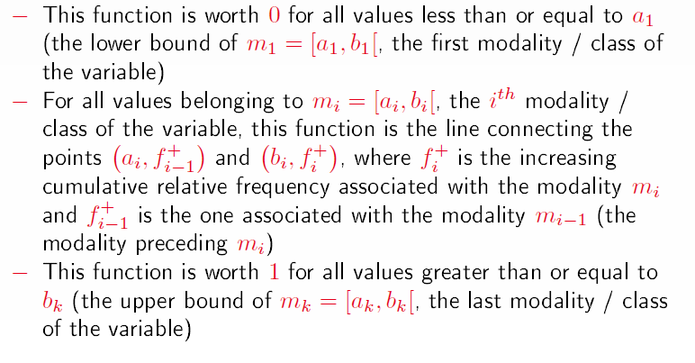
Graphical representation of data
The case of data in a continuous variable (grouped into classes)
The curve of increasing cumulative frequencies is continuous (it is not in steps)

Slide 12
Example
The data below represents the weight of 50 patients
Objectives :
- Represent graphically the data
- Plot the curve of increasing cumulative frequencies
Weight | Number of patients
[0 ; 50[ | 20
[50 ; 60[ | 12
[60 ; 70[ | 11
[70 ; 100[ | 7

Slide 13
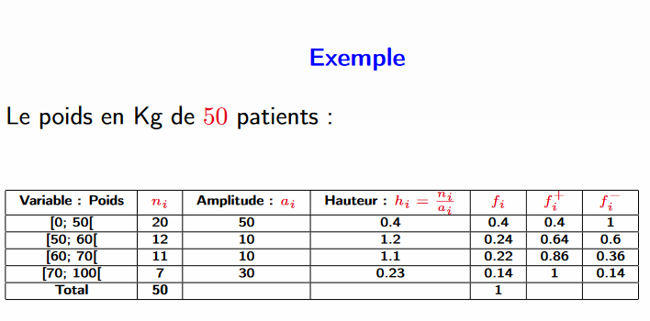
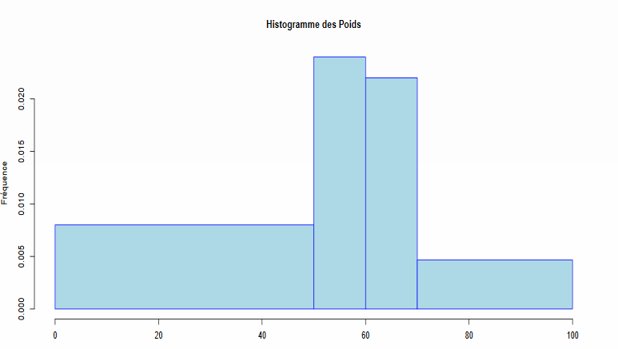
Example
The weight in Kg of 50 patients

Slide 14
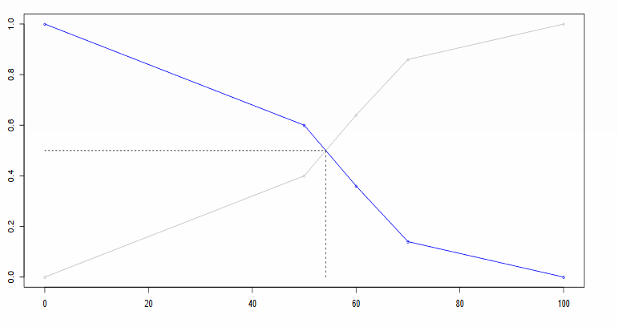
Graphical representation of data
The curve of increasing cumulative frequencies, gray color (resp. decreasing, bleu color)

Slide 15
The case of open classes
First open class → « < a »
And / Or
Last open class → « ≥ a »
By convention
The first open class is assigned the width of the second class
The last open class is assigned the width of the second last class
Remark:
If the "by convention" method takes us out of the variable definition domain, then we will use the definition domain to close the open classes

Slide 16
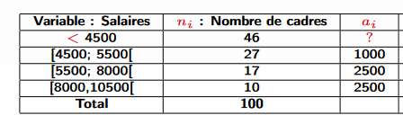
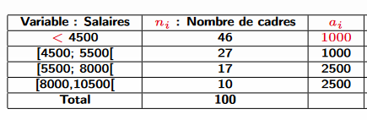
Example – First open class
The data below represents the distribution of monthly salaries of 100 senior managers
By convention, the first class would be [3500, 4500[

Slide 17
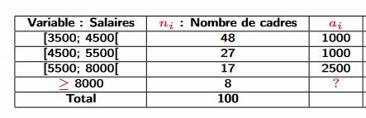
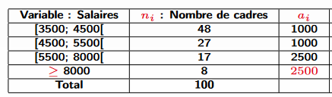
Example – Last open class
The data below represents the distribution of monthly salaries of 100 senior managers
By convention, the last class would be [8000, 10500[

Slide 18
Exercise
The data below represents the age of visitors to a website:
Find the right proposal (among the four proposals below):
The variable studied is discrete quantitative
The bar chart is the right graphical tool to represent the data
The curve of increasing cumulative frequencies is continuous
The last class can be replaced (by convention) by [50, 70[
Age | Number of visitors
< 18 | 5
[18 ; 20[ | 15
[20 ; 30[ | 20
[30 ; 35[ | 30
[35 ; 50[ | 23
≥ 50 | 7

Slide 19
Exercise
The data below represents the age of visitors to a website:
Find the right proposal (among the four proposals below):
The variable studied is discrete quantitative
The bar chart is the right graphical tool to represent the data
The curve of increasing cumulative frequencies is continuous
The last class can be replaced (by convention) by [50, 70[
Age | Number of visitors
< 18 | 5
[18 ; 20[ | 15
[20 ; 30[ | 20
[30 ; 35[ | 30
[35 ; 50[ | 23
≥ 50 | 7

Slide 20
Exercise
The data below represents the number of products purchased during the visit of 100 visitors to a shopping center:
Find the right proposal (among the four proposals below):
The variable studied is qualitative ordinal
The bar chart is the right graphical tool to represent the data
The curve of increasing cumulative frequencies is discontinuous
80% of visitors have a number of products purchased less than or equal to 2
Nb of products purchased | Number of visitors
0 | 20
1 | 35
2 | 24
4 | 16
5 | 5

Slide 21
Exercise
The data below represents the number of products purchased during the visit of 100 visitors to a shopping center:
Find the right proposal (among the four proposals below):
The variable studied is qualitative ordinal
The bar chart is the right graphical tool to represent the data
The curve of increasing cumulative frequencies is discontinuous
80% of visitors have a number of products purchased less than or equal to 2
Nb of products purchased | Number of visitors
0 | 20
1 | 35
2 | 24
4 | 16
5 | 5

